Slide 1
Reception and Year 1 Parent Information Session

Slide 2
Current climate
Mr Ince relocating to Brighton and therefore leaving at Christmas
44 spaces across the school
Infant class size regulations mean we can only have 30 children per class

Slide 3
What are we going to do about this?
Exciting new plan to share today
Combining Reception and Year 1 into 3 classes of 30 children
Renaming classes so that children all have a new identity
Continuous provision for all through 4 engaging ‘Learning Zones’

Slide 4
How do we make this happen?
Small number of children moving classes
1 class of 30 Reception children – Mrs Gill (Mulberry Class)
1 mixed class of Reception and Year 1 children – Miss Cobb (Pine Class)
1 class of 30 Year 1 children – Miss Field (Cherry Class)
Careful planning to ensure all children are supported and challenged
Curriculum coverage for both year groups
Designed in consultation with a number of external professionals

Slide 5
What will a day look like?
Children come into their ‘new’ classes for soft start and register
9:00 – children go to their ‘original’ classes for Phonics:
  Miss Cobb teaches ‘Chestnut’
  Mrs Gill teaches ‘Beech’
  Miss Field teaches ‘Oak’
  Mrs Edwards/Miss Wright teach ‘Silver Birch’

Slide 6
What will a day look like?
9:30 – Year 1 children reading groups. Reception – Handwriting lesson & Maths Mastery session.
9:55 – Snack & break
10:10 – Learning Zones carousel begins
11:00 – Learning Zone 2
12:00 – Lunchtime
1:00 – Learning Zone 3
1:45 – Learning Zone 4

Slide 7
What are the Learning Zones?
Literacy & Language
  Writing
  Role play
  Story telling
  Reading
  Phonics
  Handwriting
  Dressing up
  Fine motor skills

Slide 8
What are the Learning Zones?
Maths & STEM
  Counting
  Numbers
  Measurement
  Role play
  Money
  Time
  Understanding the world
  Investigating
  Problem solving

Slide 9
What are the Learning Zones?
Creative & Imaginative
  Paint
  Playdough
  Junk modelling
  Messy play
  Creative/design challenges
  Musical instruments
  In this zone children will also have access to the outdoor area where they will explore more, take part in activities to develop physical skills and replicate indoor learning outside.

Slide 10
What are the Learning Zones?
Small world & Construction
  Cars
  Trains
  Dolls house
  Loose parts
  Combining toys to create small worlds
  Construction toys
  In this zone children will also have access to the outdoor area where they will explore more, take part in activities to develop physical skills and replicate indoor learning outside.

Slide 11
Curriculum
Cross-curricular learning – areas that are most heavily covered within a topic have been highlighted, however, other areas will consistently be being accessed and developed through the environment
Use of high quality texts
Skills based so that activities are progressive and link from one year group to the next
Some curriculum already covered in Term 1 & 2

Slide 12
Example zone ideas for a week
Topic: Forest/Nature
Text: Owl Babies
Literacy & Language: Children to think of speech bubbles to show what the owls might be saying whilst waiting on the branch.
  Reception children may be asked to act out the scene and share verbal ideas of what the owls would say. They will then be challenged to use the phonics that they have learnt so far to write a speech bubble.
  Year 1 children may also begin this with acting out as this is a good way to help children think of ideas. They may then have a picture from the story to stick in and write a speech bubble for each of the 3 owls.

Slide 13
Forest School
All Reception and Year 1 children will now visit the forest once a week
Forest school sessions will be based on children’s interests but will also enable us to cover a lot of the curriculum
Added bonus – Year 2 will also get more time in the forest

Slide 14
School vision and ethos
FCVS Vision
Our happy children are self-confident risk takers who are excited about their learning and challenge themselves.
Our quality learning environment supports and encourages ambitious progress across all subjects with each child offered enriched experiences

Slide 15
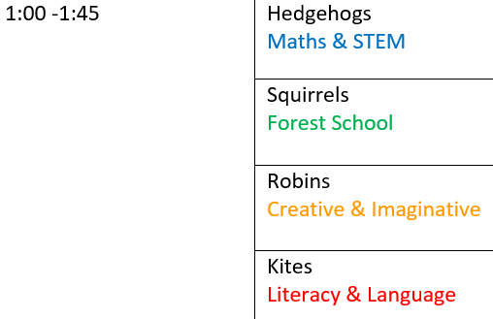
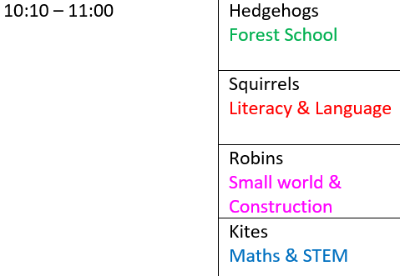
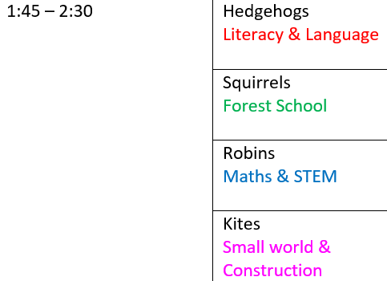
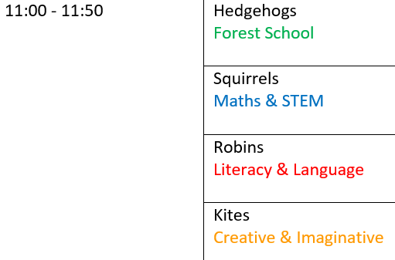
Timetable – Example day - Monday
Session 1
Session 3
Session 2
Session 4

Slide 16
Friday
Children’s choice day
Children will have spent time in all zones throughout the week
Adults will work with children on extending their learning or catching children up if they have missed things through the week

Slide 17
Staffing
Always a teacher in Literacy & Language and Maths & STEM
Highly-experienced support staff leading small group work and engaging in high quality interaction with children
Generally 2 adults per ‘zone’ but may vary slightly

Slide 18
A few other things…
Transition for those moving
Best option that ensures no further change for the children this year
No serious changes for children – familiar adults, familiar areas
Learning in a way that is more developmentally suited
PE – all children to come in wearing kit on a Tuesday from January
Quality first teaching, smaller groups
Enabling environment enhanced for Reception children
Next year

