Slide 1

Welcome to Acorn

Slide 2
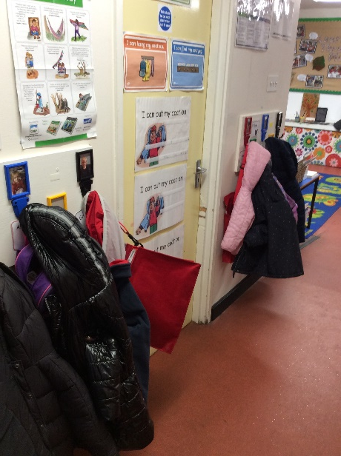
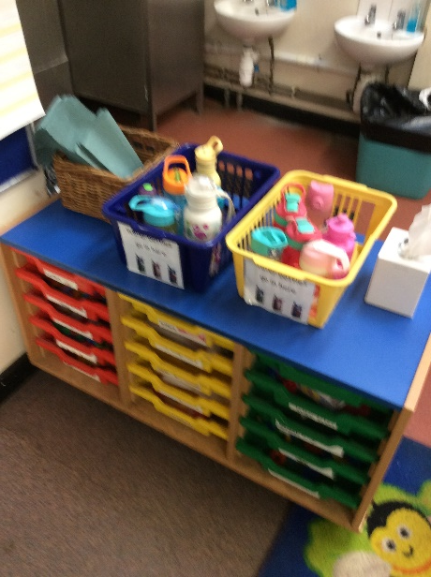
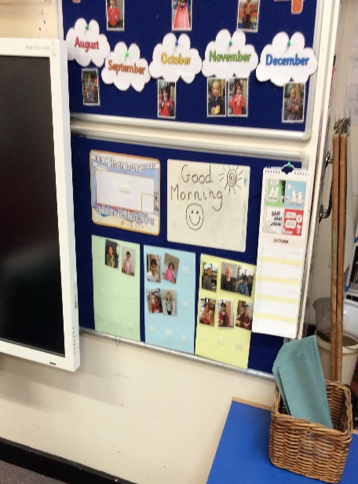

Morning Routine
The children are being helped with the routines of the morning.
They will be learning to develop their independence skills.
When they come into pre-school they are learning to take off and hang up their coats, place their water bottles in a basket, and stick up their photo to self-register.

Slide 3
A typical day in Acorn Pre-School
After the morning routine, they go off to play by choosing an activity either inside or outside.
We then do a rhyme time or group time activity, either as the whole group or in smaller Key Worker groups. This might be reading a story, doing some counting, learning about a topic, showing the children how to do a drawing/painting or a speaking and listening activity.
We then have another longer play session, where the children can move between choosing inside or outside activities. During this longer play session the children may be asked to either do a focused activity with an adult or a group activity with their Key Worker. This will usually follow on from the input they had in the earlier group time activity.
During this time the children are asked to come and have a snack which is milk or water and a piece of fruit.
We then have tidy up time followed by another group time activity for the children who go home at 12 and lunch for the children who stay until 3.
After lunch we have some quiet time followed by outside play.
We then have a group time activity followed by more free flow play.
We then tidy up and have story time before going home.
When getting ready to go home, the children are helped with their coats, book bags and water bottles.

Slide 4
What is my child doing at pre-school?
Every half term we follow a theme that applies across the different areas of the Early Years Curriculum and a Power of Reading text in Literacy.
This half term our theme is ‘Settling In’ and our Power of Reading text is, “Honey for you, Honey for me” by Michael Rosen.
Activities (this includes indoor and outdoor environment activities, Key Worker group, whole group and focused activities) are planned to meet the areas of development as set out in the Development Matters document.
Every week in the inside and outside environment there are Literacy, Mathematics, Creative, Understanding the World and Physical activities.
Other activities such as role play encourage Personal and Social and Communication and Language skills.

Slide 5
Forest School
Forest school is every Wednesday morning.
The children need to come to pre-school on Wednesdays dressed and ready to go outside for Forest School after the register.
Lots of layers are a good idea for Forest School, then with waterproofs on top. Wellies or sturdy boots are best, maybe with an extra pair of socks to keep feet warm.
When the weather gets colder please send in gloves and hats and scarves for your child.

Slide 6
From Development Matters Characteristics of Effective Learning:
Playing and exploring
Active learning
Creating and thinking critically
In the Foundation Stage the children complete lots of different activities.
They work with adults to do focused tasks.
The majority of their learning comes through play, this learning is observed and enhanced by the adults in the pre-school.

Slide 7

English/Literacy
Literacy will continue to be taught using the Power of Reading approach.
Each half term one high-quality text is chosen by each year group to form the basis of the children’s learning. A range of techniques such as drama, art, talking about illustrations, partner work, discussion and storytelling are used to explore the text slowly and in depth. These techniques ensure all children have opportunities to develop their vocabulary, increase their confidence in speaking aloud and give enthusiasm for early reading and writing.
The resources and techniques used enable us to:
  Put quality children's literature at the heart of all learning.
  Develop a high quality literacy curriculum and a whole school love of reading and writing.

Slide 8
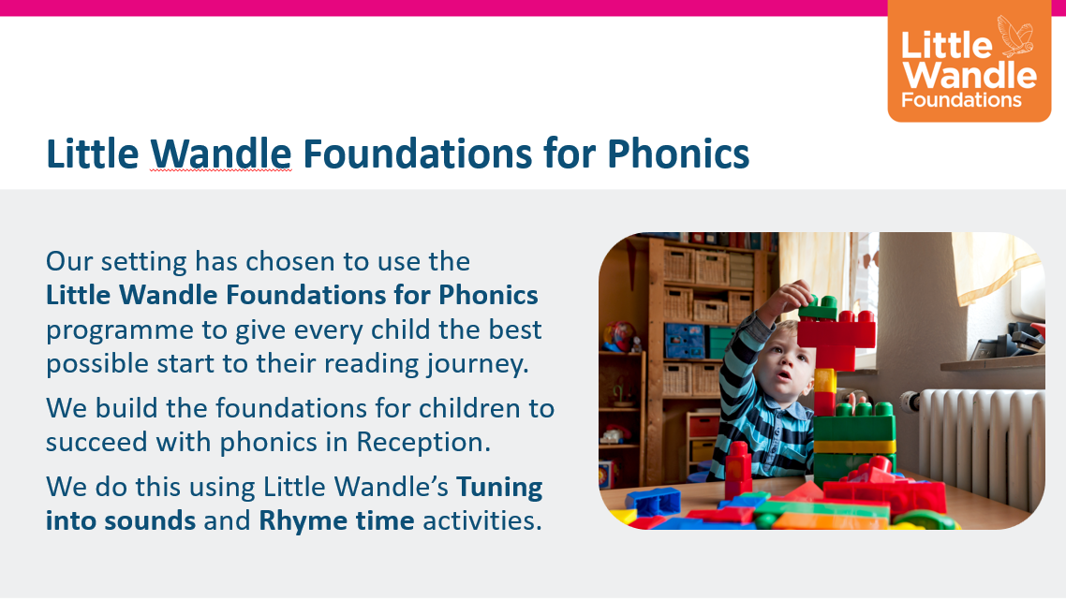

Slide 9
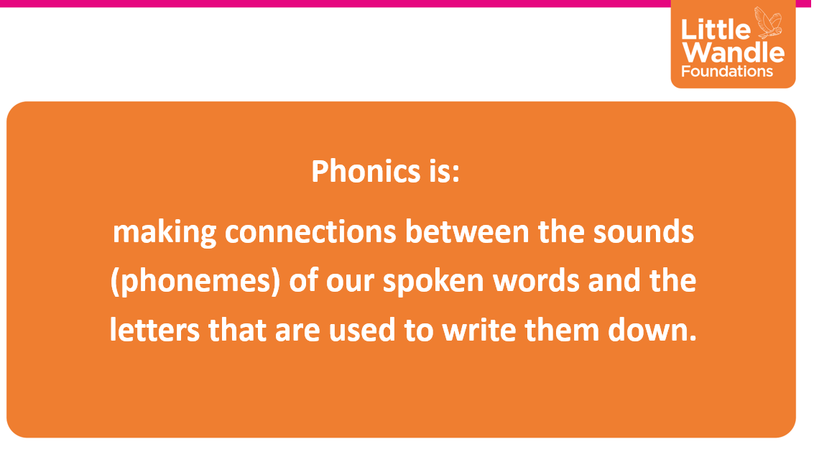

Slide 10
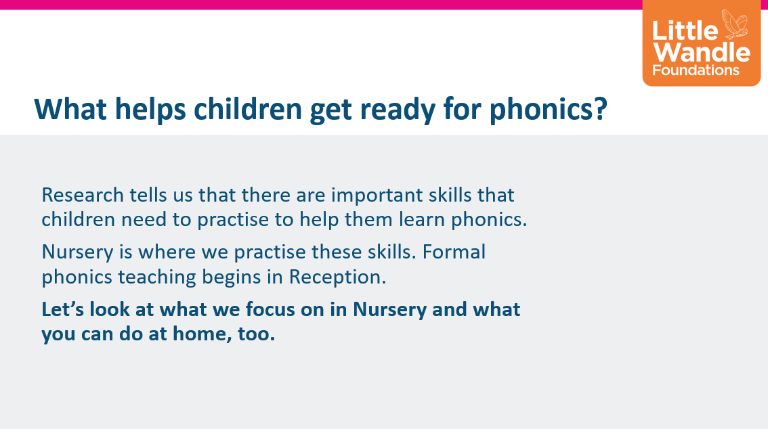

Slide 11
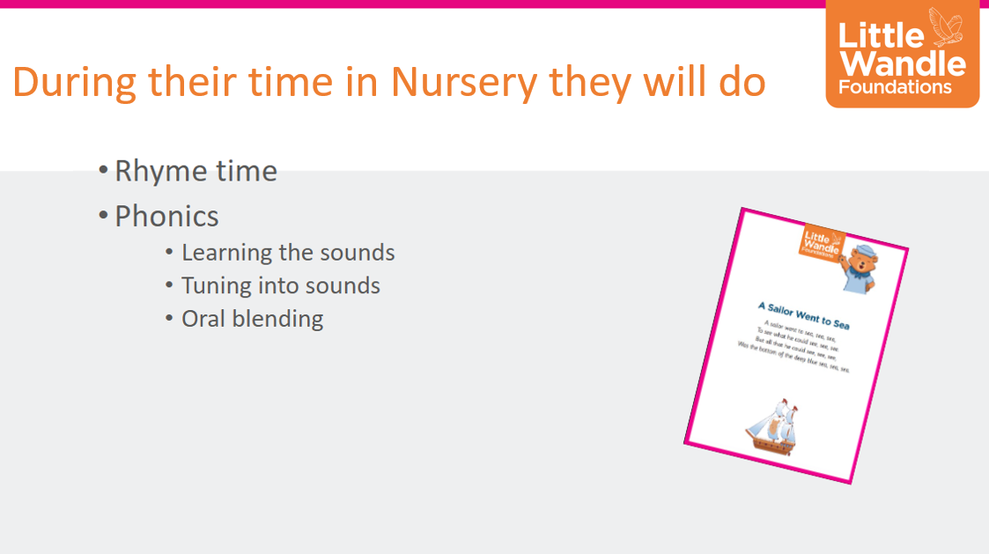

Slide 12
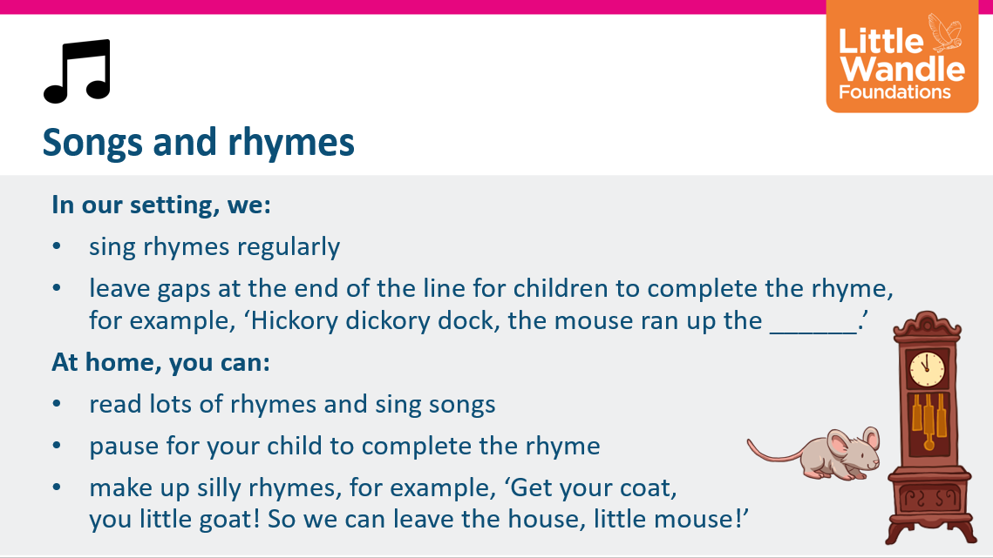

Slide 13
Story Sacks
“Reading frequently to children, and engaging them actively in stories, non-fiction, rhymes and poems, and then providing them with extensive opportunities to use and embed new words in a range of contexts, will give children the opportunity to thrive.” From the Statutory framework for the early years foundation stage.(DFE 2021)
Each week your child will get a Story Sack that they keep for the week and then return to pre-school.
Story sacks were invented by a man called Neil Griffiths.
Story sacks encourage children to extend their language and so help them to become effective communicators. They stimulate their imagination, prompt questions and require adult and child participation.
You can watch Neil Griffiths on You Tube using story sacks - he shows you how to use the props and how to build up enthusiasm for what’s in the sack this week.
‘Jenny the Story Sack Lady’ – on You Tube – watch for ideas of how to use the props.
Story sacks are checked and changed every week. Please remember to return them every week to pre-school.
We hope to get story sacks up and running before half term.

Slide 14
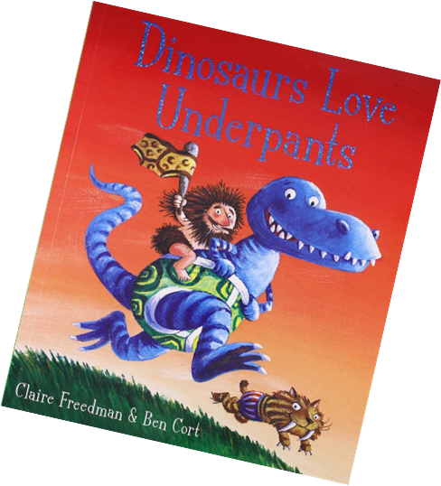
Acorn Mini Library
We hope you enjoy choosing a book to share at home.
Please remember to return your book before you choose a new one so that we can all keep sharing books.

Slide 15
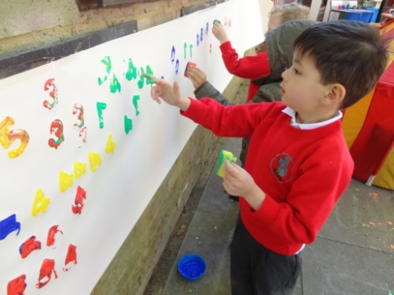
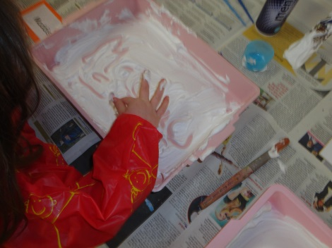
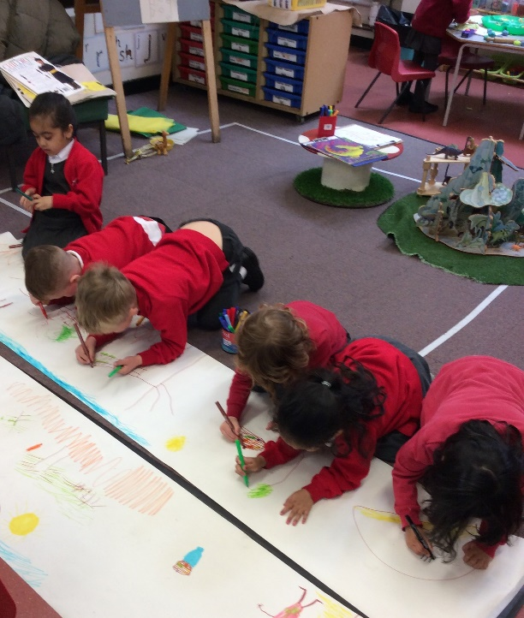
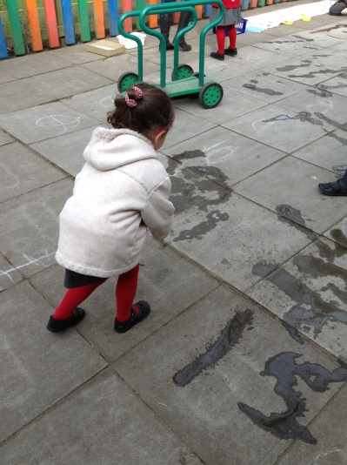
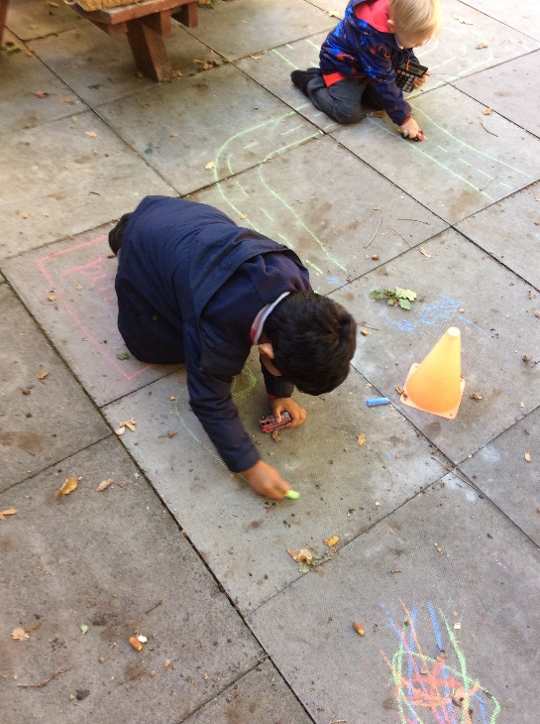
Mark making is important!

Slide 16
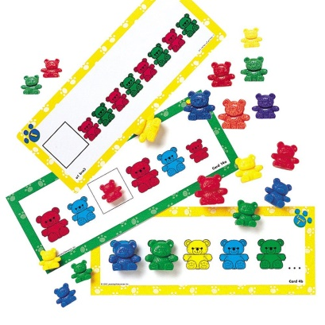
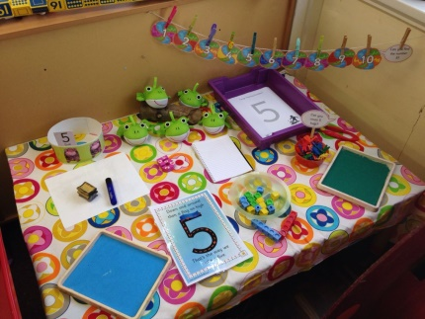
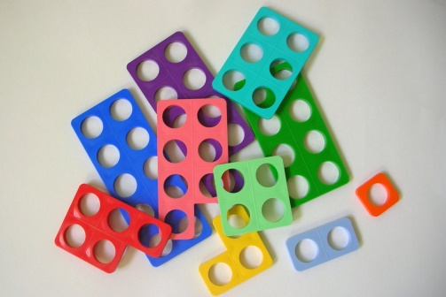
Maths in Early Years
“Mathematics for young children involves developing their own understanding of number, quantity, shape and space.”
“Effective early mathematics experiences involve seeking patterns, creating and solving mathematical
problems and engaging with stories, songs, games, practical activities and imaginative play.” Birth to 5 Matters
The “Fiveness of 5”
Numicon
Pattern making

Slide 17
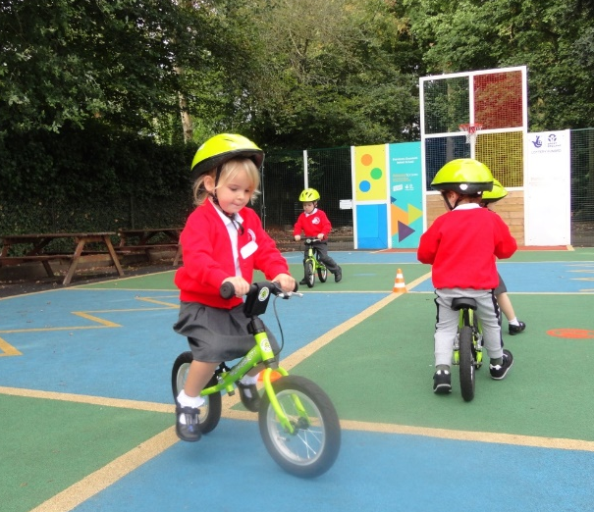
Balanceability
In the Spring term there will be an opportunity for all the pre-school children to take part in a Level 1 six week balance ability course.
Level 1 is aimed at children aged 2 ½ to 4 years old.
It focuses on movement patterns, gross motor skills and dynamic balance using a balance bike.
Children learn how to pick up, manoeuvre, mount and dismount their bikes and then learn the skills to ride a balance bike safely.
Children are then able to transition to riding a pedal bike in a safe, rewarding manner and are set on the way to enhancing their physical literacy.

Slide 18

Class Dojo
We will be using Class Dojo to communicate between school and home.
Children can create their own characters.
You will get notified of when your child receives a dojo.
Skills selected that follow alongside the schools values and rules.

Slide 19
Ways to help your child at home
Read lots of books and talk about stories and make up stories.
Use mathematics in everyday situations.
Encourage lots of activities that help develop fine motor strength for example play dough, building with Lego, squeezing water on paint from sponges, finger painting etc.
Encourage lots of mark making.
Encourage independence with everyday tasks such as coats and shoes.

Slide 20
Further Information
Guidance to your child’s learning and development in the early years foundation stage. ‘What to expect in the Early Years Foundation Stage, a guide for Parents.’
What to expect in the EYFS’ – DfE
https://foundationyears.org.uk/files/2021/09/What-to-expect-in-the- EYFS-complete-FINAL-16.09-compressed.pdf
Please remember when reading this document that every child is different and children do not grow and develop at the same rate.

Slide 21
Reminders
Lunches – please order even if it’s to say your child is having a packed lunch so we know we have everyone covered.
Use Class Dojo to communicate with us.
We are always happy to call after pre-school if you have any questions.
Please send in a named water bottle (filled with water) everyday.
Please label all of your child’s belongings.☺
Any tissue box donations would be gratefully received.

Slide 22
Any Questions?

