Slide 1

Welcome to Reception!
Beech and Chestnut Class
Mrs Gill and Miss Cobb

Slide 2
Reception Life
There are 7 different areas of learning in The Early Years; Personal, Social and Emotional Development, Communication and Language, Physical Development, Literacy, Mathematics, Understanding the World and Expressive Arts and Design.
Lots of their learning comes through play, this learning is observed and enhanced by adults.
The children also complete lots of different activities.
The skills the children learn are the skills that will follow them throughout their lives.

Slide 3
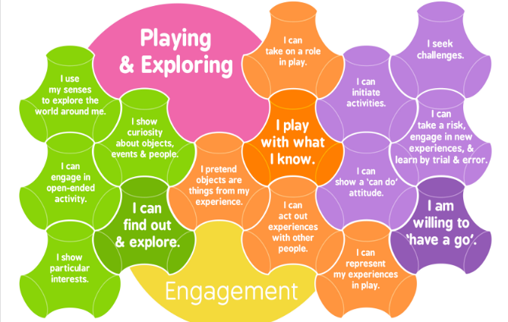
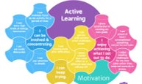
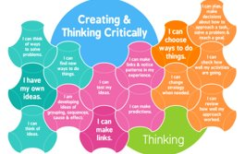
Characteristics of Effective Teaching and Learning:
Children investigate and experience things and ‘have a go’.
Children concentrate and keep on trying if they encounter difficulties and enjoy achievements.​
Children have and develop their own ideas, make links between ideas and develop strategies for doing things.

Slide 4
A day in the life of a
Reception child…
8.45 – 9.00 = Soft Start
9.00 – 9.30= Register and Phonics
9.30 – 10.15 = Choosing (Independent play and adult led activities)
10.15 – 10.30 = Snack
10.30 - 10.50 = Maths
10.50 – 12.00 = Choosing (Independent play and adult led activities)
12.00 – 1.00 = Lunch and Playtime
1.00 – 1.30 = Carpet Time: Literacy /topic
1.30 – 2.30 = Choosing (Independent play and reading practice)
2.30 – 2.45 = Story and Home time at 3.00

Slide 5
Literacy

Slide 6
The English Language
The English language is very complex.
44 sounds are used to make all the words in the English Language.
But there are only 26 letters in the alphabet.
This can make learning to read and write English very hard for children.

Slide 7

Little Wandle Letters and Sounds Revised
Our school has chosen
Little Wandle Letters and Sounds Revised as our Systematic Synthetic Phonics (SSP) programme to teach early reading and spelling.
Notes:
Slide purpose:
To inform parents that all schools must teach phonics in Reception, but explain your school's choice of SSP
Suggested script:
The National Curriculum specifies that all schools must teach children to read using phonics in Reception.
Read the slide.

Slide 8
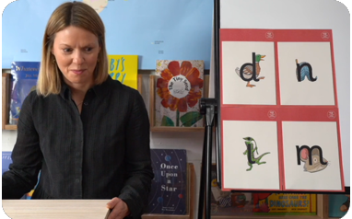
This term:
This term we start by teaching phase 2 sounds and blending.
By the end of reception we will have taught phase 2, 3 and 4,
We start teaching from week 2 of Reception
The lessons are fun, interactive, engaging and have been designed to gradually build over time.
Notes:
Slide purpose:
To introduce Phase 2
Notes
Read the slide.

Slide 9
Jargon
Phoneme- a single sound.
1 mouth movement is a sound e.g. a, t, m, p
Grapheme – the written symbol or group of symbols that represent a sound.
Digraph- 2 letters that make up one sound
Trigraph – 3 letters that make up one sou
Light
Shop

Slide 10
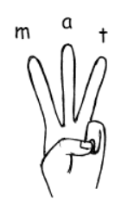
How we teach phonics
First we start to blend sounds together to read words.
eg: c-a-t, s-o-ck, p-i-n
We then learn to segment the sounds in a word so that we can write it.
We use our segementing fingers to help us count the sounds in words.
Mat
Shed
Blow
Light
Careful not to ‘schwa’! ... cuh-a-tuh
It takes children a long time to un-learn schwa-ing!

Slide 11
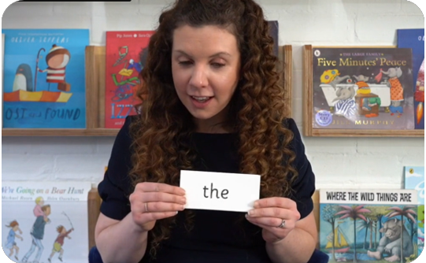
Tricky words
These words have unusual spellings e.g. he, the, was.
They are taught in a systematic way.
Children are now learning to read the Phase 2 tricky words: is, I, the, put, pull, full, as, and, has, his, her, go, no, to, into, she, push, he, of, we, me, be.
Notes:
Slide purpose:
To introduce tricky words
Notes:
Read the slide.
You may wish to give parents a copy of the document ‘Phase 2 tricky words: Reception Autumn term – Information for parents and carers'.

Slide 12
How do we practise reading in books?
Reading practice sessions are:
timetabled three times a week
taught by a trained teacher/teaching assistant
taught in small groups
children in Reception will bring a book home by week 4 of the first half-term.
Notes:
Slide purpose:
To introduce decodable books
Suggested script:
The children read the same book three times in a week.
The first time we work on decoding (sounding out) the words, the second time we work on prosody which is reading with expression – making the book sound more interesting with our story-teller voice or our David Attenborough voice – and the third time we look at comprehension.
We read the books three times at school because we want to develop the fluency.
The more children see words, the more they begin to read them automatically without having to sound them out.

Slide 13
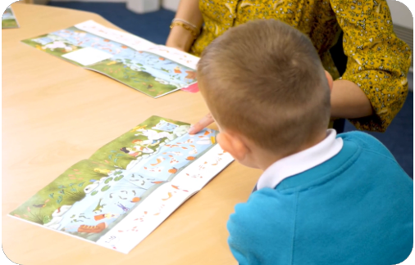
Reading a wordless books
Wordless books are invaluable as they teach reading behaviours and early reading skills to children who are not blending – yet!
Talk about the pictures.
Point to the images in the circles and find them on the page.
Encourage your child to make links from the book to their experiences.
Notes:
Slide purpose:
To give guidance on reading wordless books at home
Notes:
Read the slide.

Slide 14

Your child’s Reading Folder
Each child will receive a Reading Folder.
Please keep this inside your child’s book bag.
Inside you will find their reading record and
their reading book along with their library book
for sharing.
They will have their books changed once a week. Please complete the reading record so we know that they have read at home with you. Any adult reading with them at school will mark the record with S to show that they have been read with at school.

Slide 15
Listening to your child read their phonics book
Your child should be able to read their book without your help.
They might sound out words and blend them before they read them fluently.
If they can’t read a word, read it to them.
Talk about the book and celebrate their success.
Notes:
Slide purpose:
To give guidance on reading the decodable book at home
Notes
Read the slide.

Slide 16
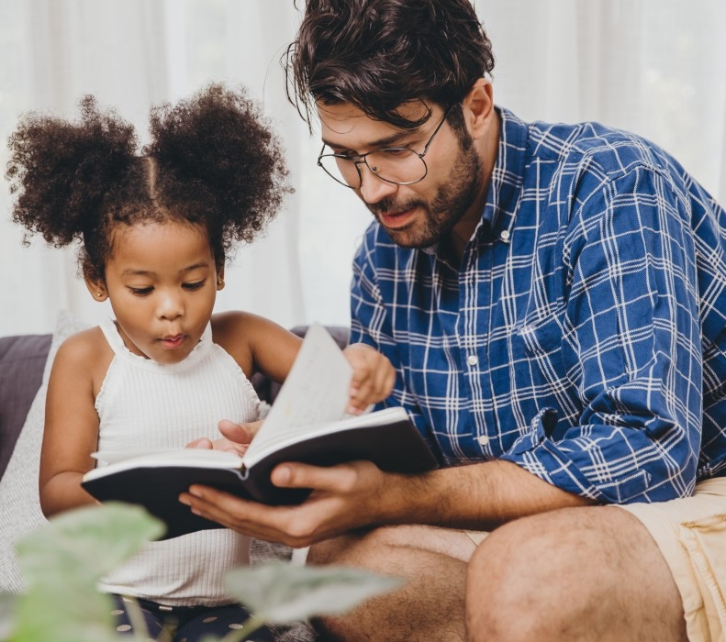
The most important thing you can do is read with your child
Reading a book and chatting had a positive impact a year later on children’s ability to…
understand words and sentences
use a wide range of vocabulary
develop listening comprehension skills.
The amount of books children were exposed to by age 6 was a positive predictor of their reading ability two years later.
Parental involvement in the development of children’s reading skills: A five-year longitudinal study (2002) Senechal, M. and Lefvre, J
Notes:
Slide purpose:
To summarise key takeaways
Suggested script:
Celebrate your child’s success at school.
Make time for reading at home!

Slide 17
Phonics at home
We will be sending home phonics work.
This will be the sounds that we have learnt that week and how to practise writing the letters.
It has the rhyme that the children have learnt to write the letters i.e. 'down the snake from head to tail.'
The children will be given their phonic files on Thursday and these need to be returned to school on a Tuesday.
Please take the time to sit down with your child and discuss how they remember the sound and recap other sounds that they have learnt.

Slide 18

If you would like to learn more about Little Wandle and how we teach phonics, please visit the website https://www.littlewandle.org.uk/resources/for-parents/

Slide 19

Power of Reading
Literacy will be taught using the Power of Reading approach.
Each half term one high-quality text is chosen by each year group to form the basis of the children’s learning. A range of techniques such as drama, art, talking about illustrations, partner work, discussion and storytelling are used to explore the text slowly and in depth. These techniques ensure all children have opportunities to develop their vocabulary, increase their confidence in speaking aloud and give enthusiasm for early reading and writing.
The resources and techniques used enable us to :
  Put quality children's literature at the heart of all learning.
  Develop a high quality literacy curriculum and a whole school love of reading and writing.
  Use varied, engaging and effective learning opportunities.

Slide 20
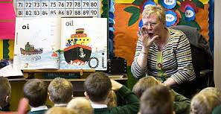
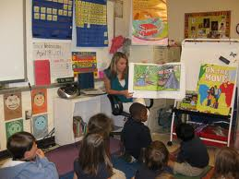
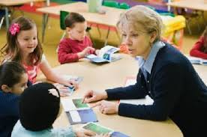
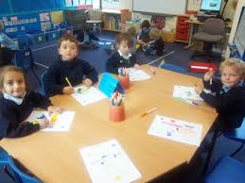
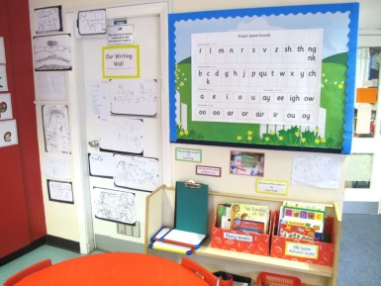
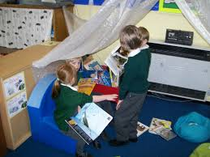
Learning to Read
-Phonics
-Power of Reading
-Shared Reading
-Reading Practice
-Adult Led Activities
-Print in the Environment
-Reading at home
-Reading for pleasure

Slide 21
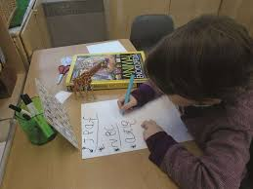
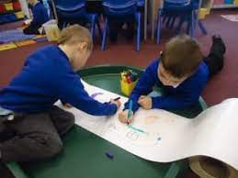
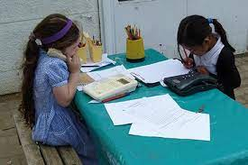
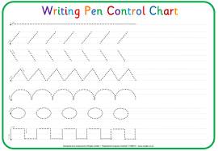
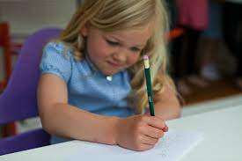
Learning to Write
-Daily name writing
-Fine motor activities
-Letter writing in phonics
-Adult Led Activities
-During choosing
-Phonics homework
-Writing at home
-

Slide 22
Maths

Slide 23
How we teach Maths
This year we will be using Maths Mastery which is run by the National Centre for Excellence in the Teaching of Maths (NCETM)
We will be focussing on subitising, the composition of numbers, ordinality – where numbers sit, comparison and number fact knowledge.
We will have a sequenced progression of skills to teach. These will be taught in short whole class sessions and connected experiences, small group work and in the classroom environment.

Slide 24
P.E and Forest School
We will be starting P.E and Forest School this week.
P.E will be on a Tuesday every week. Please ensure your child has their P.E kit in school.
Your child will go out to the Forest every other week on a Thursday or Friday morning. You will send them in ready for Forest school and we will help to change them at lunchtime.
You should have received a letter with your child’s colour group, forest school dates for this half term and what to wear. If not, please see us at the end and we will provide you with the information.

Slide 25

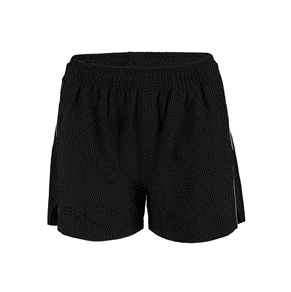
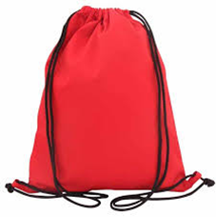
PE – Tuesday's
Children need their PE bag on their peg in school.
School jumper/fleece, black/navy shorts, white T-shirt and trainers.
In the colder months black/navy joggers.
Please name everything!
No jewellery to be worn (except any religious jewellery which needs to be covered with a sweat band).
Hair tied up.

Slide 26
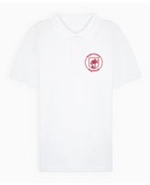
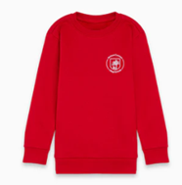
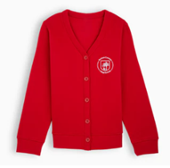


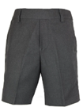

Uniform
Our school uniform consists of:
A white polo shirt, with or without the school logo.
A red sweatshirt or cardigan, with the school logo.
Grey tailored trousers, tailored shorts, skirts or pinafore dress.

Slide 27
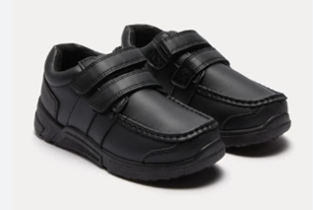
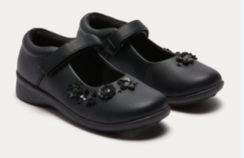
Uniform
Children should wear black school shoes, preferably that fasten with Velcro. Boots and trainers should not be worn.
Socks and tights should be plain and in the school colours – grey, black, white or red.
Hair up.
Hair ties, clips, ribbons or ‘scrunchies’ should be in school colours.
If your child wears earrings: small gold or silver studs

Slide 28
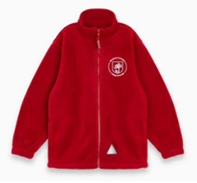
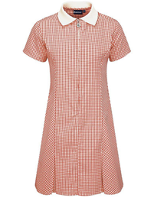
Uniform
Children may also have:
A red school fleece with the school logo
A summer dress in red and white

Slide 29

Class Celebrations
We will be using Class Dojo to communicate between school and home.
Children can create their own characters.
You will get notified of when your child receives a dojo.
The skills selected follow alongside the schools' values and rules.
We also have a marble jar which promotes working as a team for a rewards e.g parachute games, stories in the forest

Slide 30
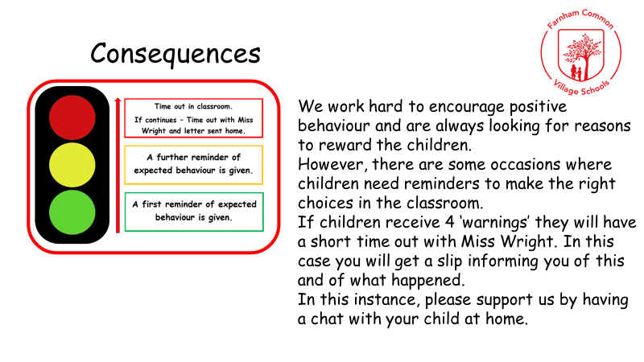

Slide 31
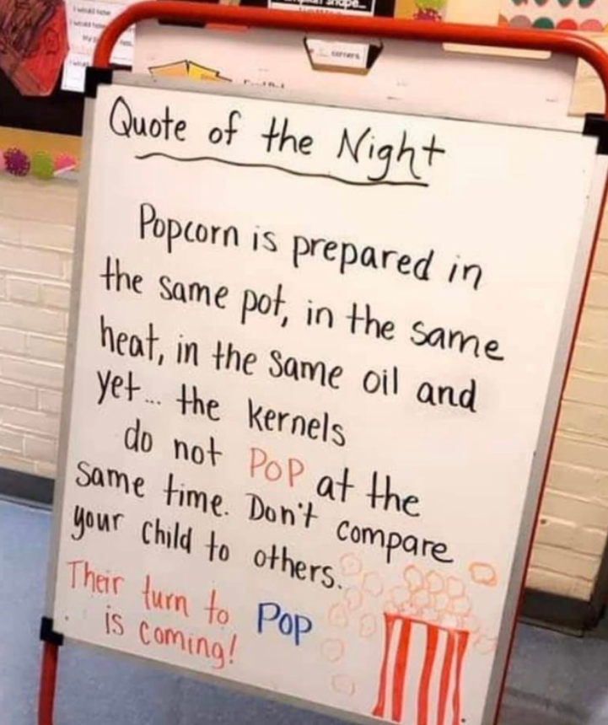

Remember – it’s a journey not a race!

Slide 32
Reminders
We are always happy to meet and discuss anything further after school.
Please encourage your child to speak to an adult in school if there are any concerns.
Please label all of your child’s belongings including water bottles/wellies/book bags.
Please ensure that your child only has water in their water bottles.
Please send in a family photograph for us to display.

Slide 33
Useful Links
Little Wandle Parent Info
https://www.littlewandle.org.uk/resources/for-parents
Parent Info- helping with phonics etc
http://www.oxfordowl.co.uk/for-home/reading-site/expert-help/phonics-made-easy
Oxford Owl- 250 free eBooks
https://www.oxfordowl.co.uk/for-home/find-a-book/library-page/
‘What to expect in the EYFS’ – DfE
https://foundationyears.org.uk/files/2021/09/What-to-expect-in-the-EYFS-complete-FINAL-16.09-compressed.pdf

Slide 34
Any Questions?

