Slide 1

Year 6
September 2024– July 2025

Slide 2
The team!
Mrs Brunton and Miss Ashford are class teachers for Linden.
Mrs Jordan is class teacher for Juniper.
The team is supported by Mrs Ruck, Mrs Sajid, Mrs Lebby and Mrs Shephard.

Slide 3
What is Year 6 all about?
The purpose of Year 6 is to prepare children for secondary school by building on, consolidating, using and applying their skills and knowledge from lower down in the school and developing independence.
Also, to have a memorable final year in their Primary education.

Slide 4
Overview of the year (dates)
11+ Results - 11th October (If you registered the results will be emailed, if you did not a letter will be sent from Bucks)
Applications for secondary schools deadline:
31st October
SATS – w/c 12th May 2025
River Dart residential w/c 16th June 2025
Transition – Summer term
Production – Summer term

Slide 5
FCVS Curriculum Design
Our aim is a curriculum that builds knowledge, develops creative thinking and promotes independence.
We have planned a creative curriculum which is skills based and knowledge rich.
Planning is split into three terms – Discover (History themed and DT themed) , Explore (Geography themed) and Create (Arts and DT themed)
This provides the children with the opportunity to study areas of the curriculum in greater depth.

Slide 6
FCVS Curriculum Design
Each term the children will complete a Project Book which will showcase what they have learnt throughout their topic and which they will bring home at the end of the school year.
For example, this term we are learning about WW2 and the children will create a project book which will record their journey through the key events of the war.
We will also hold a WW2 day towards the end of the Autumn term for them to extend their learning experience.

Slide 7
Creative Curriculum – topic areas covered
Autumn term (Discover) – WW2 (community, prejudice, resilience)
Spring term (Explore) – Climate Change (consequences, responsibility, duty)
Summer term (Create) – Leaving a legacy(change, pride, ambition)

Slide 8
Creative Learning (trips and outdoor learning)
We have the following trips booked for this coming school year:
Chiltern Open Air (13th September)
Burnham Beeches (Autumn &Spring Term)
River Dart/Enrichment Week (16th June)

Slide 9
Organisation for Maths and English
The children will be in their own classes for maths and english. Work will be differentiated to support all learners.

Slide 10

English
English will continue to be taught through the Power of Reading scheme.
These resources enable us to :
  Put quality children's literature at the heart of all learning
  Develop a high quality literacy curriculum and a whole school love of reading and writing.
  Use varied, engaging and effective learning opportunities - practice that is underpinned and supported by robust classroom-based research.
In this year group, we will be starting with ‘Goodnight Mr Tom’.

Slide 11
English
Whole class guided reading
Spelling
Grammar and punctuation
Handwriting

Slide 12
Expectations (Homework)
Spellings: these will be given out on a Thursday and the homework must be
handed in by Monday. Spelling tests will be on a Thursday morning.
Maths: Our current focus is on ensuring that all of the children are fluent in all
of the times tables. They should be using TT Rockstars 2-3 times a week. We
will also set homework on Maths.co.uk on a Friday. The children will have until
Wednesday morning to complete the work.
English/Creative curriculum: A homework sheet has been sent home with
a range of tasks for the children to choose from. They must complete 3 before
half term and another 3 before Christmas (we expect one piece of homework to be
handed in every fortnight).
Reading: we recommend that children read every evening for around 10
minutes and encourage the children to complete a log of their reading in their
reading records. Books can be borrowed from school or the children can read
their own books from home. Their reading record should be handed in each morning.

Slide 13

Sometimes given as homework
Children can login at any time at home and play. Teachers can see the progress they make.
Certificates will be awarded for Rock Stars, Rock Legends and Heroes.

Slide 14
Behaviour and Expectations
Classroom Rules.
Encouraging the children to be more independent and resilient.
Strong understanding of the school values (respect, resilience, integrity, innovation and empathy).
Dojos will be awarded for excellent work, behaviour and following the school rules as well as showing a good understanding of the school values.
The children also have the opportunity to apply for different roles such as: Head Boy, Head Girl, Sports Leaders, House Captains and Librarians. The children have been told how they can apply for the various roles and are only able to hold one position.

Slide 15
Routines
Ensure your child packs their own bag properly EVERY DAY!
Collection and dropping off of your child – punctuality (8:45 am registration)/permission to leave unaccompanied.
Playtimes – healthy snacks and water
Lunchtimes – packed lunches/pre-order hot dinners
PE Kits – To be worn to school only on Tuesday and Friday. Trainers should only be worn on PE days.

Slide 16
School Uniform
Well done – your children look very smart!
School jumper/cardigan ONLY
Shirt only with top button closed and tucked into trousers/skirts/shorts
School tie with the colour of your child’s house.
Black shoes not trainers and they must be ALL black.
School colours for socks/ hairbands. No big bows! (black, grey, white – red hairbands
are also acceptable)
All items need to be named.
Hair longer than shoulder length needs to be tied back at all times.
Earrings – should only be simple studs and if possible, not worn on PE days. If this is not possible, please provide microporous tape.

Slide 17
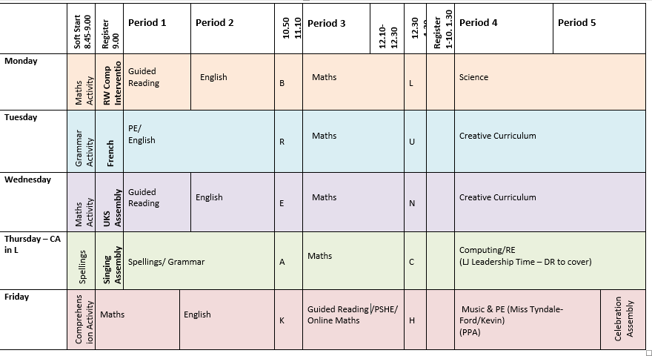
Year 6 Timetable

Slide 18

Questions…

