Slide 1

Year 5 Meet the Teacher
2023

Slide 2

Meet the team!
Hawthorn
Mrs Paton and Miss Ashford (Tuesday)
Cedar
Mrs Long
Supported by: Mrs Parry, Mrs Lebby,
Mrs Mangan, Mrs Shephard, Mrs Frewin

Slide 3

Behaviour and Expectations
Encouraging the children to be more independent and resilient
Class Dojos
PE Days: Tuesday (outside)
Friday (indoors)
Swimming – 10wks – Fridays
Cedar : 22nd Sept
Hawthorn: 12th January

Slide 4

School Uniform
Well done – your children look very smart!
School jumper/cardigan ONLY
Shirt only with top button closed
Black shoes not trainers and they must be ALL black.
School colours for socks/ hairbands. No big bows!
All items need to be named.
Hair longer than shoulder length needs to be tied back at all times.
PE Kit must be FCVS PE kit.
Earrings – should only be simple studs and if possible, not worn on PE days. If this is not possible, please provide microporous tape.
Earrings must be taken out for swimming.

Slide 5
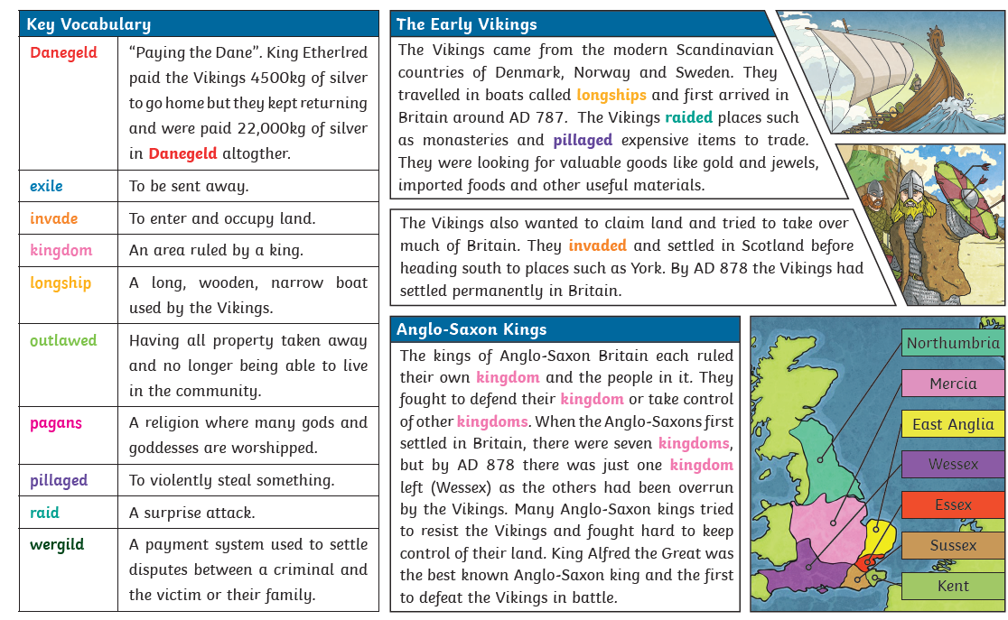
Discover
Viking Day- Tuesday 26th September.
Anglo-Saxon and Vikings

Slide 6
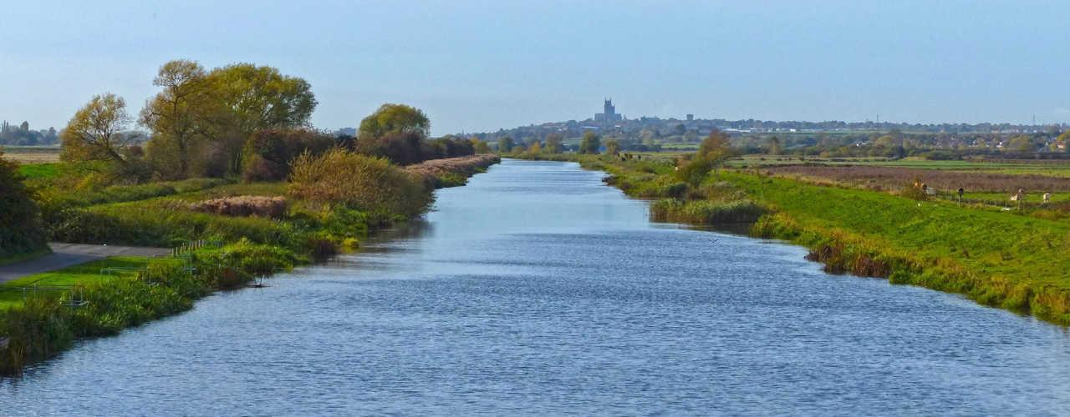

Year 5 Curriculum
Explore- Geography based- Rivers and North America
Create- Space

Slide 7

Regular practice makes a huge difference to times tables fluency which helps all aspects of Maths
Children can login at any time at home and play. Teachers can see the progress they make.
Certificates will be awarded in celebration assembly for Rock Stars, Rock Legends and Heroes.

Slide 8


English
English will continue to be taught with some texts from the Power of Reading Scheme. We have started our term off with How To Train Your Dragon by Cressida Cowell.
Whole class guided reading 3 times a week.

Slide 9

Reading
Reading homework is still very important!
Aiming for every night.
Read to an adult or read independently – adult to sign the reading record weekly, child to fill in each night.
Children responsible for changing their own books in school.

Slide 10
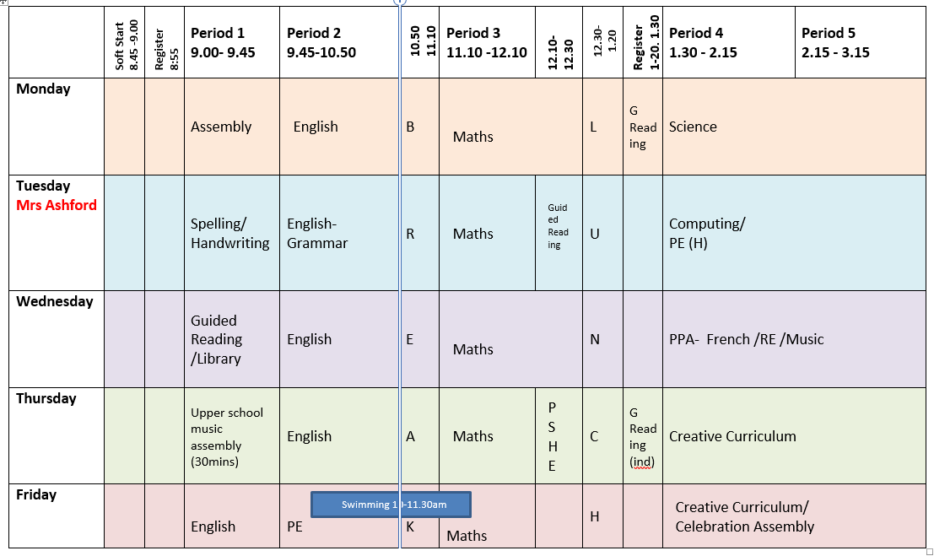

Slide 11
Homework timetable
Spelling
Set on a Tuesday and due in on Monday.
Maths
Set on a Friday, due in on Wednesday (mixture of TTRS, MyMaths and Prodigy).
Creative Curriculum
6 tasks need to be completed over the term. 3 of these need to be from the writing column and 3 from the creative column.

Slide 12
Routines
Encourage your child to take responsibility for checking their book bag every day.
Collection and dropping off your child. Start of school day is 8:45 pm, for a soft start. End of the day is 3:15 pm. Please let the office know if you are happy to allow your child to walk home unaccompanied.
Playtimes – healthy snacks and water
Lunchtimes –see office for hot dinners.

Slide 13
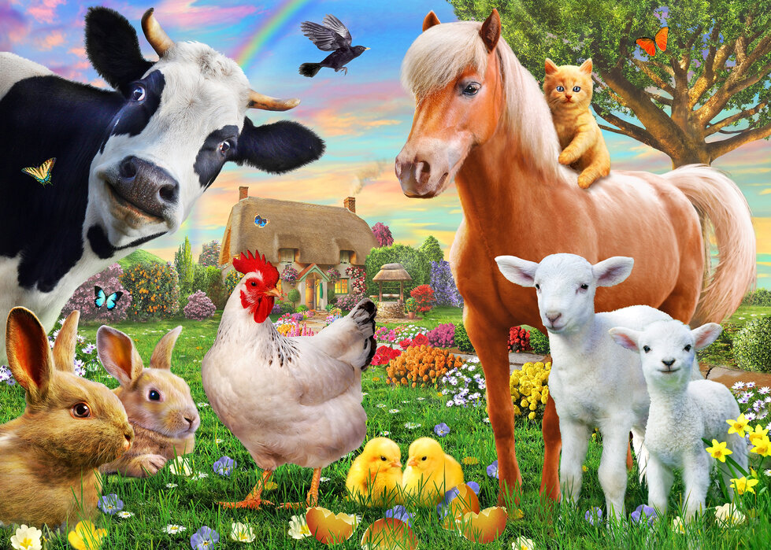
Residential
Off to New Forest to stay on a working farm.
Cedar 7th – 9th May
Hawthorn 13th – 15th
Details to follow

Slide 14

Communication with the teacher
Reading Record
Class Dojo
Phone the school office

Slide 15
Any Questions?

